Slide 1

A new screening program is initiated in a population for disease X…
There is no effective treatment available for disease X (to change the natural history of the disease or the outcome)

Slide 2
The screening test has proven to be 98% effective in correctly identifying people who have disease X in its earliest stages. This is referred to as the screen’s:
Reliability
Specificity
Sensitivity
Positive Predictive Value
Notes:
C

Slide 3
What will happen to the incidence in this population one-year after screening is initiated?
It will decrease
It will increase
It will remain constant
Notes:
B
What will happen to incidence in the long-term (it will not change)

Slide 4
What will happen to prevalence one year after initiation of screening in this population?
It will decrease
It will increase
It will remain constant
Notes:
B

Slide 5
What will happen to the case-fatality of Disease X?
It will decrease
It will increase
It will remain constant
Notes:
A
Case fatality is a measure of __________ (mortality)
Are case fatality rates truly rates?

Slide 6
What will happen to the mortality rate from disease X?
It will decrease
It will increase
It will remain constant
Notes:
C

Slide 7
The over-representation of slowly progressing disease as a result of screening is referred to as:
Lead-time Bias
Volunteer Bias
Latency Bias
Length-time Bias
Notes:
D

Slide 8
What will happen to the survival rates for disease X as a result of screening?
It will decrease
It will increase
It will remain constant
Notes:
what might be the problem with this apparent increase in survival? (it will be inflated as a result of lead-time bias)

Slide 9
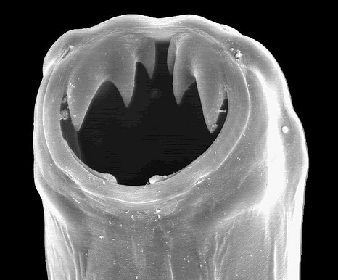
Class 15: The epidemiology of infectious disease
HLSC 2003 | Walker | Faculty of Health Sciences
Notes:
The “sexy” part of epidemiology – made sexier by Hollywood
Rare to know of someone who dies of infectious disease these days. 150 years ago, it was most common to die from some sort of infectious disease. Why the shift? Medical advances vs. public health (social reforms)

Slide 10
Class OBJECTIVES:
Lots of terminology and definitions…
Definition and overview of infectious disease
Epidemiologic Triangle
Determinants of disease transmission
Principles of outbreak investigation

Slide 11
Malaria Primer: LINK
AGENT: protozoan parasite – genus Plasmodium (P. falciparum, P. vivax, P. ovale, P. malariae)
TRANSMISSION: through bites from infected female Anopheles Mosquitoes (bite between dusk and dawn).
PATHOLOGY: Once inside the human body, parasites multiply in the liver and invade red blood cells
SYMPTOMS: Signs and Symptoms: fever, headache, vomiting; life-threatening if not treated as blood supply to vital organs disrupted (e.g. kidney failure, low BP, problems with coagulation, severe anemia, ect.)
INCUBATION PERIOD: Infects 7-30 days after bite
HIGH-RISK GROUPS: children, pregnant women, international travellers, immigrants people with HIV/AIDS, geographic location (endemic areas)
Notes:
Long incubation periods can result in missed diagnosis.

Slide 12
Malaria Primer: IN 2013…
GLOBAL MORTALITY:
584 000 deaths(90% of deaths from malaria occur in Africa)
Mortality rates decreased by 74% between 2010 and 2013
Globally, 453 000 children died before their fifth birthday due to malaria
GLOBAL MORBITIDY:
198 million cases
PREVENTION & TREATMENT: preventable and treatable
Personal protection
Control of mosquitoes
Early Diagnosis
Prophylactic and disease treatment
No vaccine
Elimination goals

Slide 13
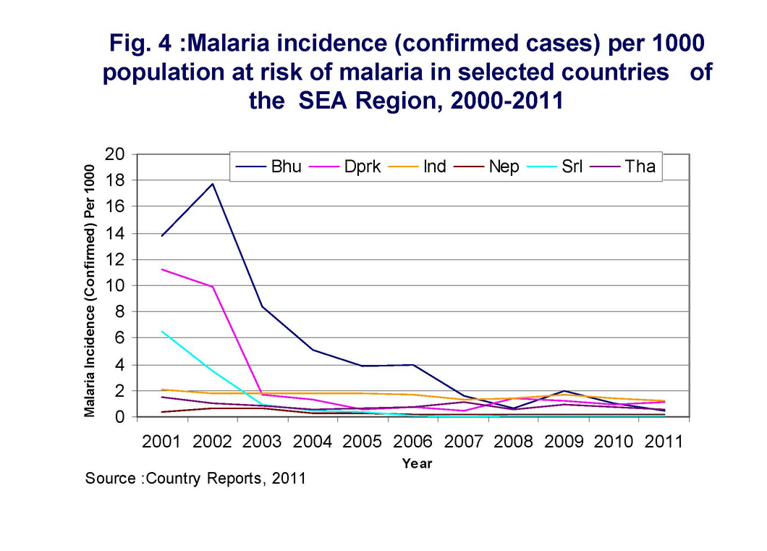
Descriptive epi: SECULAR TRENDS
LINK to source
Gradual changes in disease frequency over a long period of time.

Slide 14
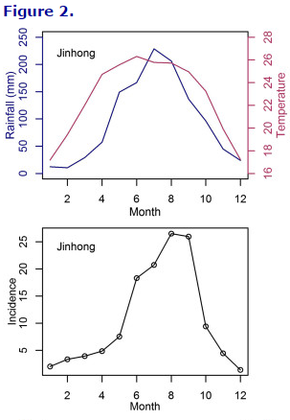
Descriptive Epi: Seasonal (Cyclical) Trends
Increases and decreases in disease frequency over a period of several years or within a year
LINK to source
Notes:
Another example is seasonal flu

Slide 15
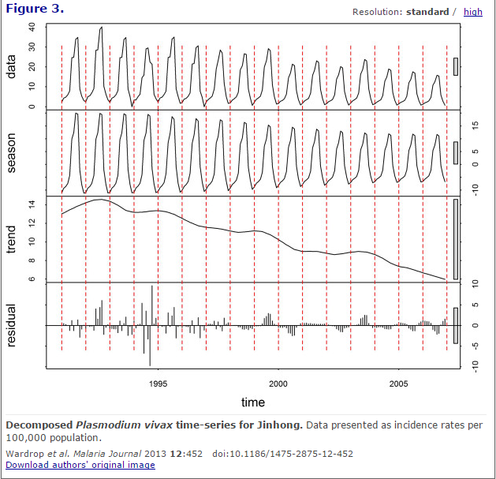
Describing Malaria by time: Secular and cyclical trends
LINK

Slide 16
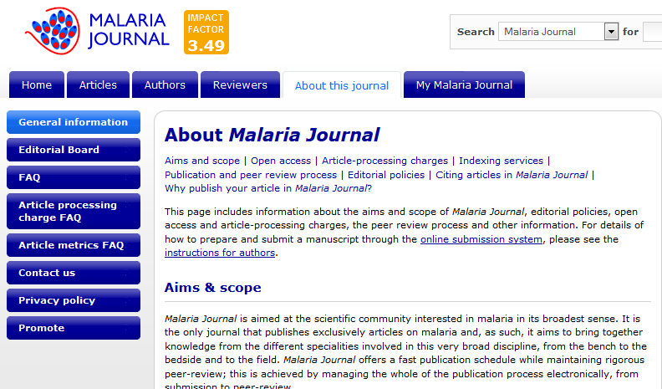

Slide 17
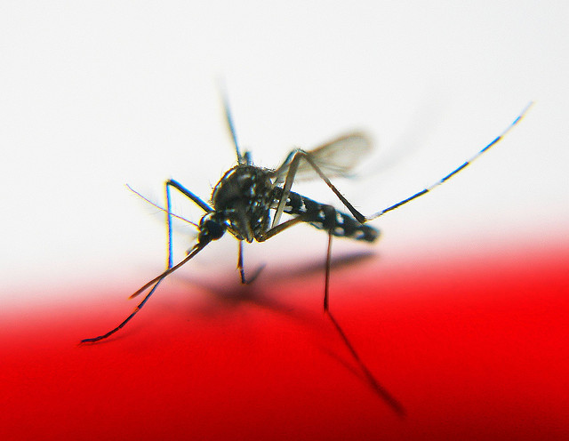
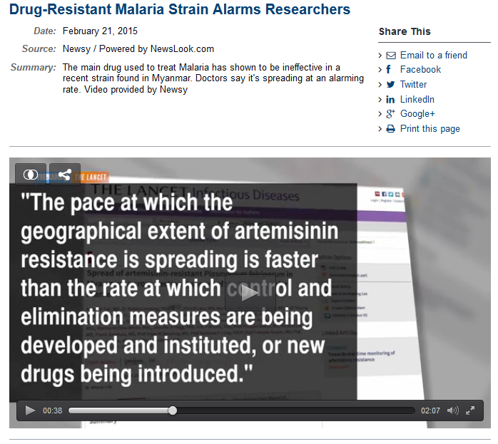

Epi in the News:
I’m resistant with K-13!
LINK to news
LINK to article

Slide 18
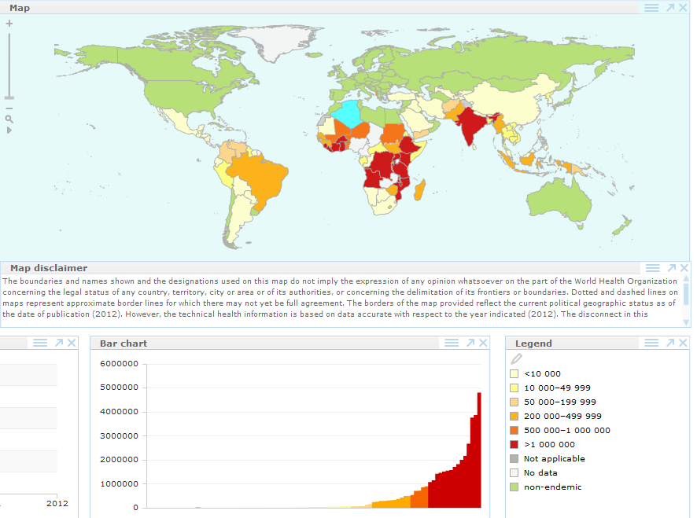
MALARIA:
Confirmed cases in 2012
How many in Canada?
SO…who cares?

Slide 19
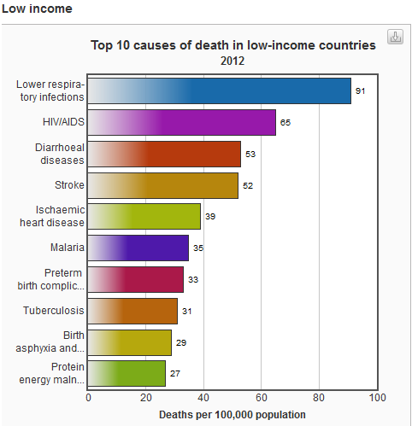
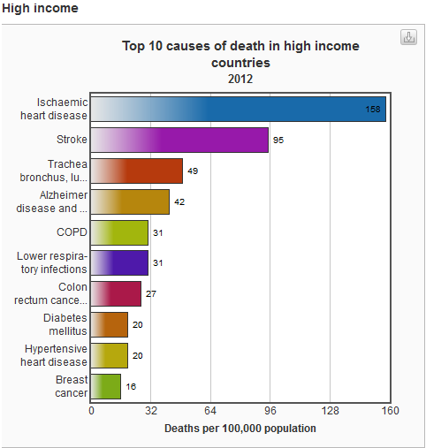
Top 10 causes of death globally
Notes:
Number of infectious diseases in top 10 in low income countries: 5
In high income countries: 1

Slide 20

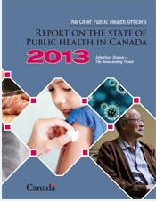
Canada: infectious disease threats?
“we must not become complacent”
“we must remains vigilant”
“we will continue to be challenged by infectious disease in the future”
Non-immunized populations
Antibiotic resistance
Nosocomial infections
Food and water-borne infections
Tuberculosis/STIs
Emerging threats
Globalization
Others unknown…
Chief Public Health Officer Report PHAC, 2013
Notes:
We have come a long way…however….

Slide 21
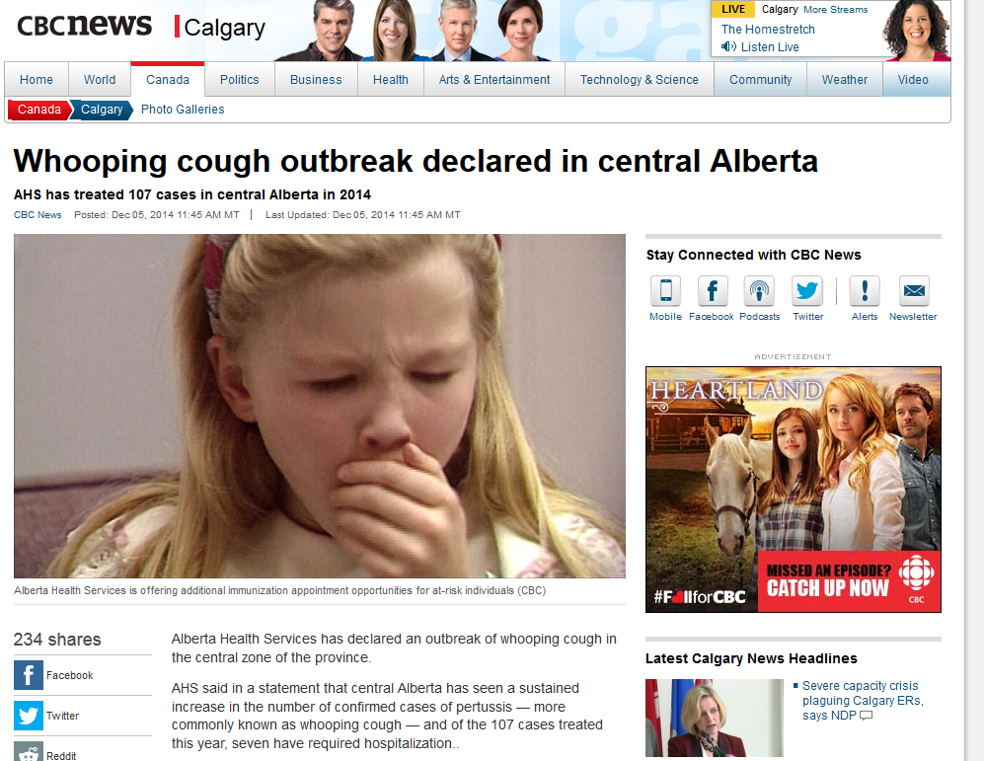
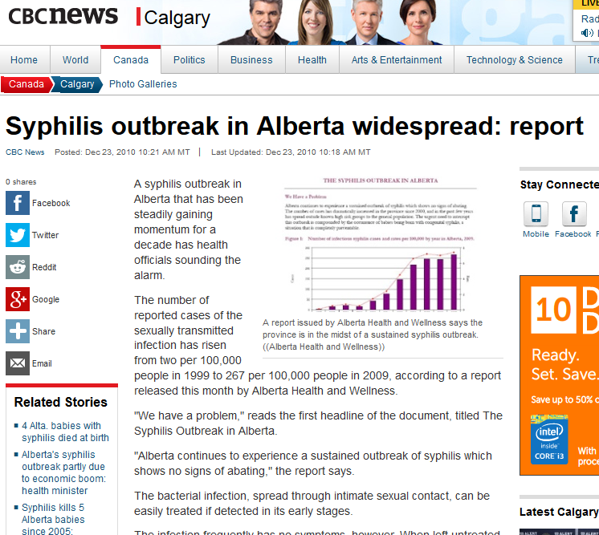
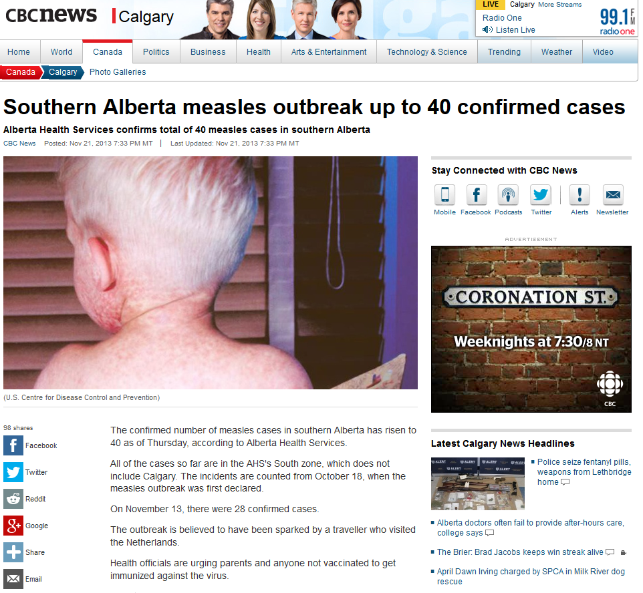
Link to Whooping
cough
Link to Syphilis
Link measles

Slide 22
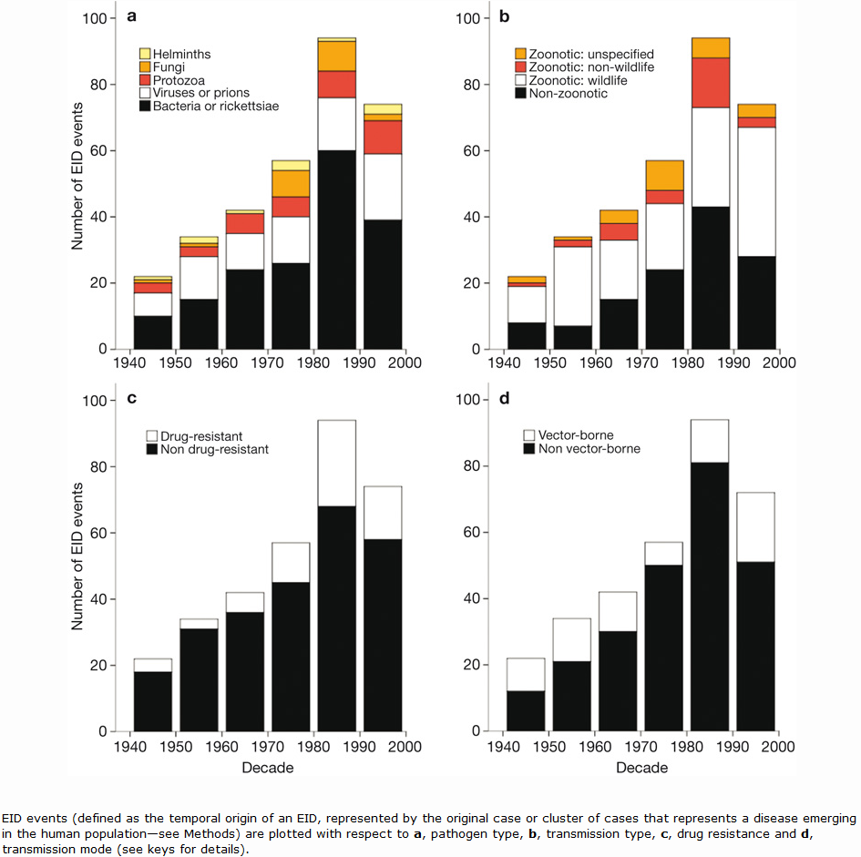
Emerging Infectious Diseases (EID)
Original case or cluster of cases representing an infectious disease emerging in human populations
335 between 1940 and 2004
LINK to article

Slide 23
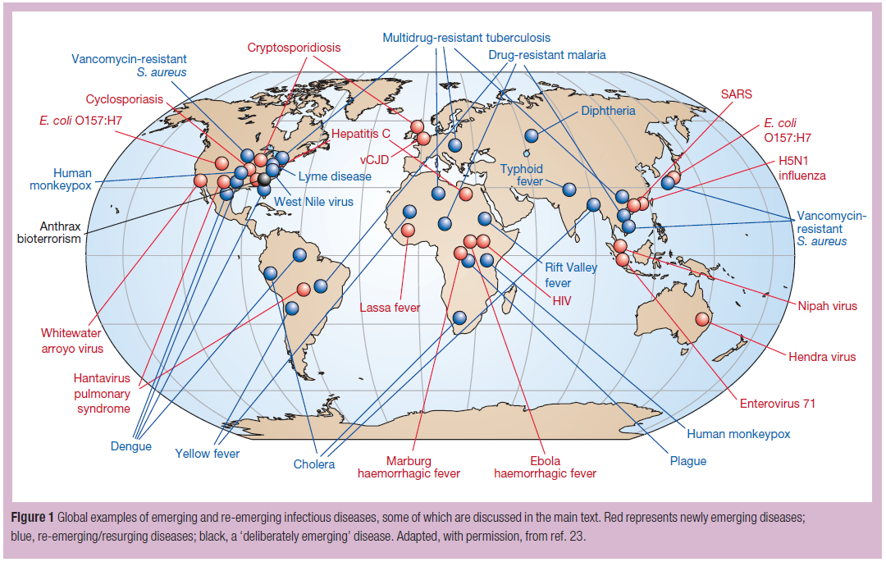
Morens, Folkers, & Fauci (2004).

Slide 24
EID
Emerging Diagnosis:
H. Pylori
Hepatitis
Cervical carcinoma
Newly emerging:
HIV/AIDS
Norovirus
SARS
West Nile Virus
Avian Influenza
Japanese encephalitis
Ebola
Emerging resistance:
Multi-resistant TB
Multi-resistant malaria
MRSA
HIV
Re-emerging:
Dengue Fever
Cholera
TB
Malaria
Syphilis
Measles
Adapted from Kramer, Kretzschmar, Krickeberg (2010). Modern Infectious Disease Epidemiology…

Slide 25
Factors leading to emergence of infectious diseases
Population growth
Climate change
Increased antibiotic use (in humans and animals)
Encroachment of human populations in forest habitats
War as social disruption
Relocation of animals
Changing social environments (e.g. daycare)
Aging population
Human-animal contact
Intent to harm (bioterrorism)
Microbial adaptation
International travel
Advancements in science

Slide 26
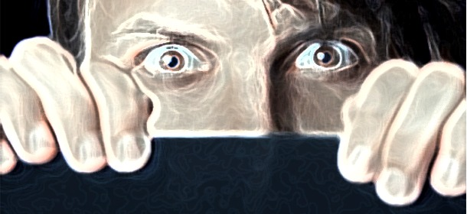
Infectious (communicable) Disease:
Image: http://gaia-health.com/wp-content/uploads/2015/02/Fearful-Man.jpg
Disease caused by a specific pathogenic agent within a susceptible host
Notes:
Infectious diseases are, essentially, one living organism preying on another. (survival of the fittest)

Slide 27
Key terms:
EPIDEMIC (OUTBREAK) – the occurrence of disease in a community or region clearly in excess of what is expected
ENDEMIC – the constant presence of a disease or infectious agent within a given geographic areas or population group
Holoendemic – infects everyone, but children most intensely affected; most adult immune (malaria)
Hyperendemic – constantly present with high incidence and prevalence rates and affecting large proportion of all age groups (influenza)
PANDEMIC – diseases affecting large numbers of people and crossing international boundaries
CLUSTER – aggregation of relatively uncommon disease in a space and/or time in amounts that are perceived to be greater than could be expected by chance (often environmentally driven)

Slide 28
Natural history of disease
Every disease follows a potentially predictable life cycle from onset to outcome. Understanding the natural history of disease allows for more effective prognosis, treatment, prevention, and control.
Disease
Human Infection
Outcome
Notes:
The need for microbiology, immunology, pathology, medicine

Slide 29
Epidemiologic Triangle
Link
Host
Agent
Transmission
Environ-ment
Notes:
Disease results from an interaction between the components of this triangle. Represent the “Determinants of Disease” (HPDD)
Understanding infectious disease has been the result of a complex set of scientific fields that studied cause, determinants, hosts, and agents
(teaching this in Haiti…or to children can be difficult. Imagine back to the day when there was no biological “proof” that infectious agents existed).
The work of Hippocrates, Robert Koch, Jenner, Snow, and many others have all contributed…resulting in this model which illustrates and communicate the interplay of agent, host, and environment
Goal of epi is to understand the relationships and interactions between the aspects of this model so that the connections might be broken or disrupted.

Slide 30
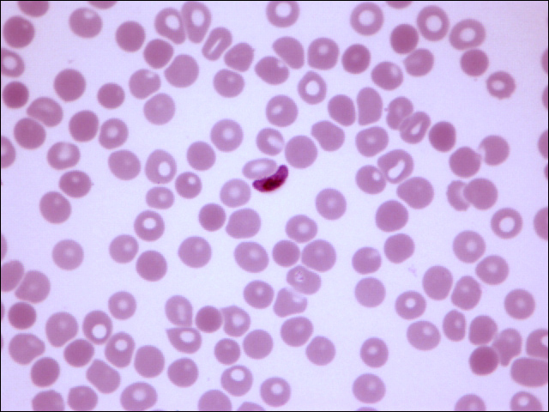
http://pathmicro.med.sc.edu/para-lab3/plasmodium_falcipurum_100X.htm
Notes:
Agent – Plasmodium (parasitic protozoa)

Slide 31
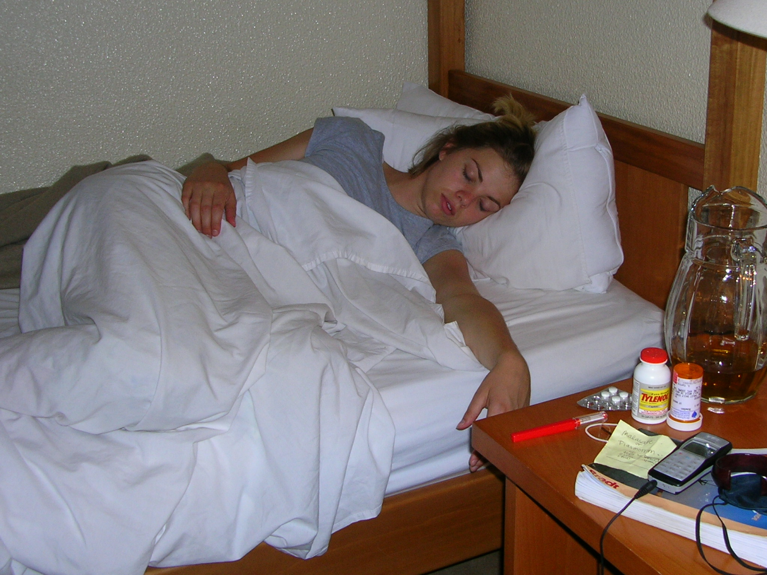
Notes:
Host – me, lack of immunity, prophylactic treatment, general health,

Slide 32
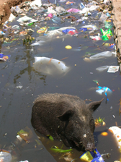
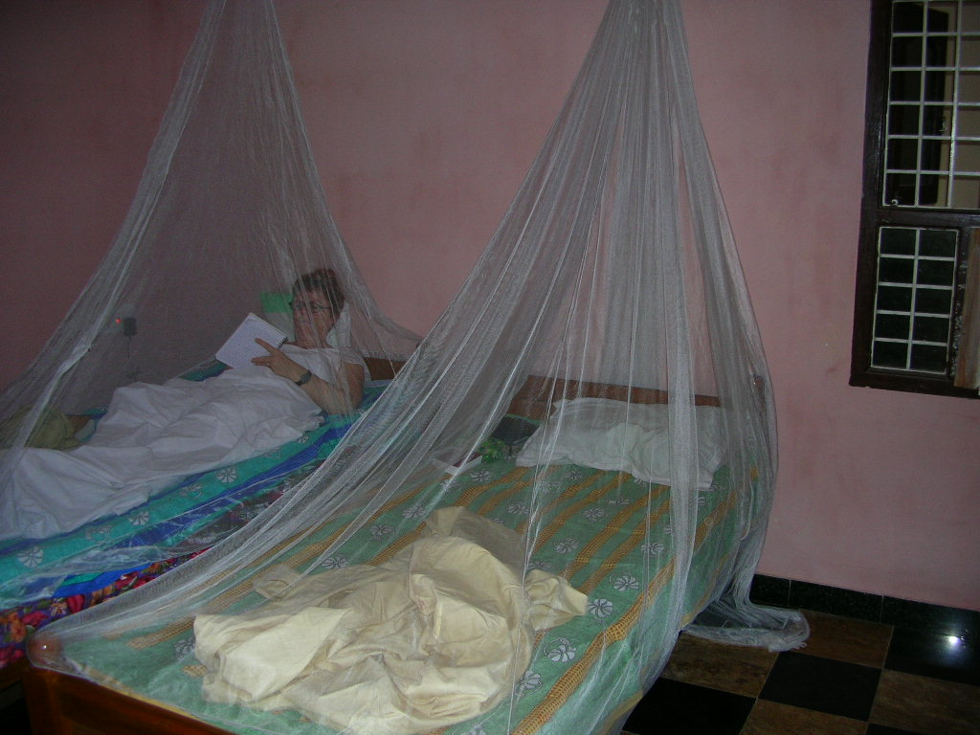

Notes:
Environment – standing water, lack of vector control, wet, preventative interventions available

Slide 33
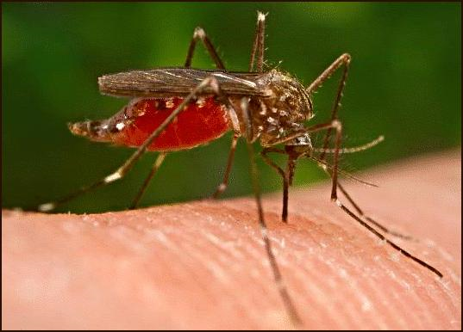
http://grannyherbs.com/?p=146
Notes:
Transmission - Vectors – female anopheles mosquito

Slide 34
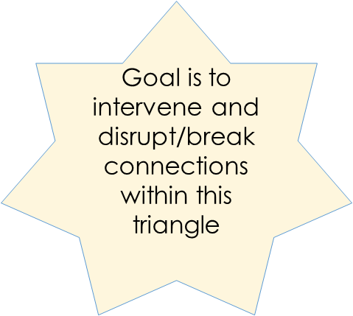
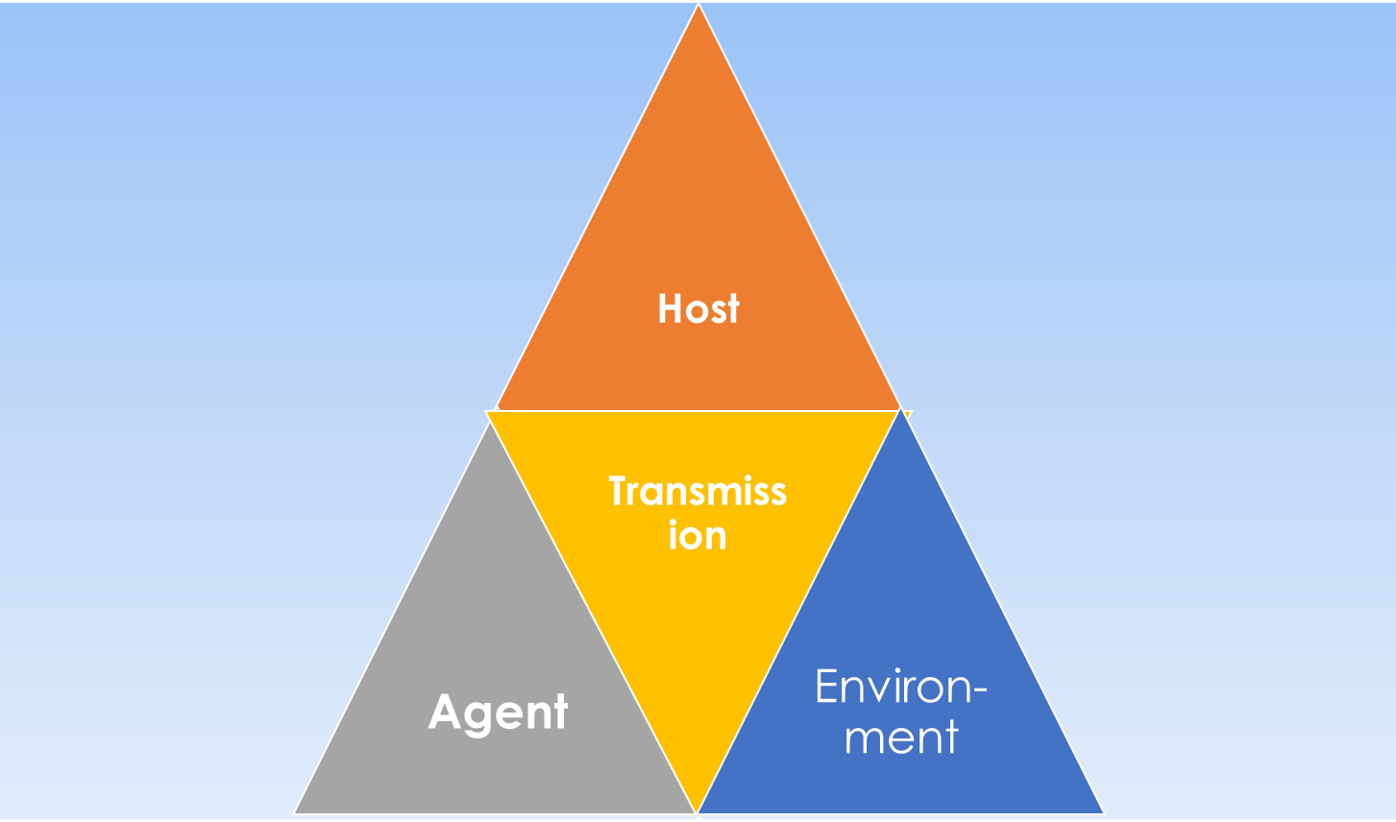
“It is important to maximize our knowledge of the biology and pathogenesis of disease, but…the absence of this knowledge should not be a hindrance or an excuse for not implementing effective preventative services.”
-Gordis (2014, p. 15)

Slide 35
Host
Agent
Trans-mission
Environ-ment

Slide 36
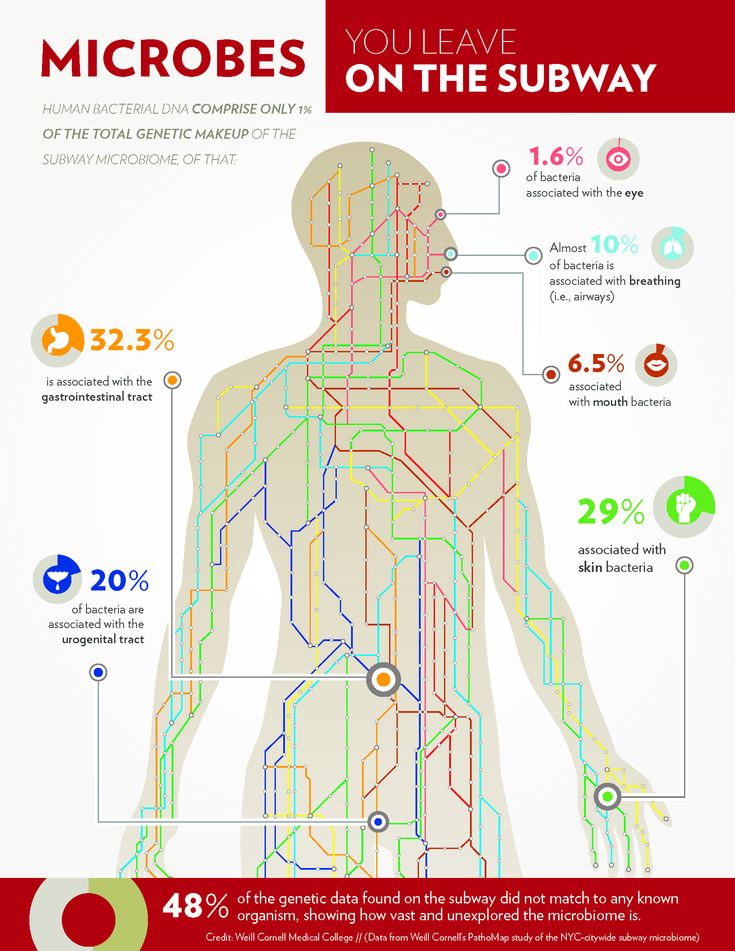
Agent:
Classified into groups: monsters inside me
Bacteria
Viruses
Fungi
Protozoa (including parasites)
Agents exist everywhere…Bubonic plague in the NYC Subway?!
Antimicrobials kill or inhibit growth of infectious agents and are grouped according to the microorganism they act against (e.g. antibiotics, antivirals, antifungals, antimalarials)

Slide 37
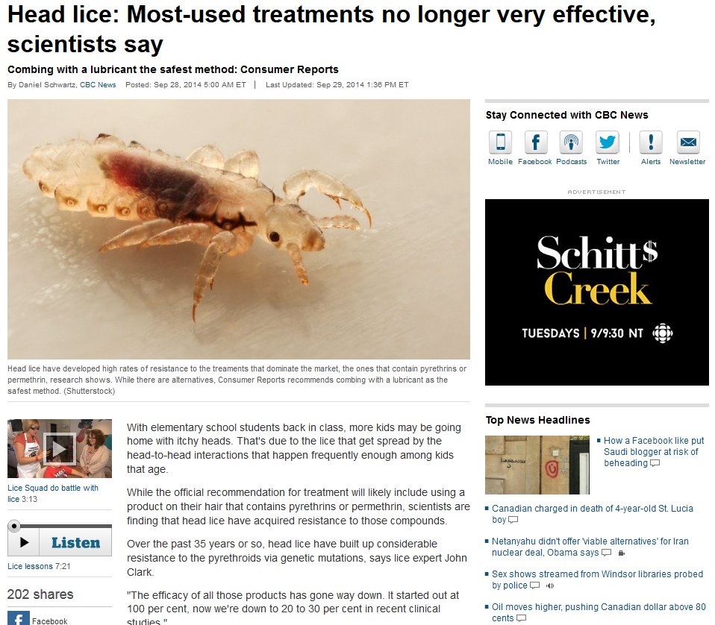
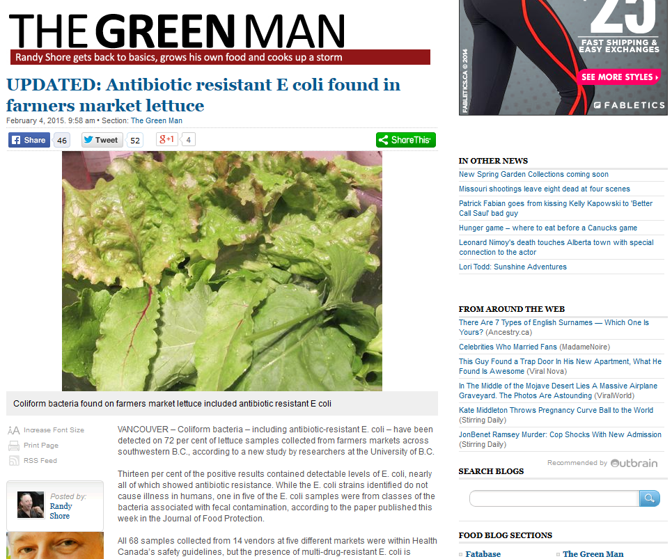
Antimicrobial resistance:
Resistance of a microorganism to an antimicrobial drug that was once effective for treatment of infections
The fight against Multi-drug resistant Tuberculosis
LINK (WHO)
LINK (PHAC)
Notes:
Why is this bad?
-inability to treat disease
-increased mortality
-increase morbidity
-need for other, potentially high-risk proceedures/treaments
-impacts disease control efforts
-costs a lot to the healthcare system
-jeopardizes health gains within societies

Slide 38
Characteristics of agents:
INFECTIVITY – the ability of the agent to invade and multiply in the host (and thus result in infection)
PATHOGENICITY – the power of the agent to produce overt illness in the host
VIRULENCE – the ability of the agent to produce serious illness or death
ANTIGENICITY – ability of the agent to induce antibody production in the host (stimulating and immune response)

Slide 39
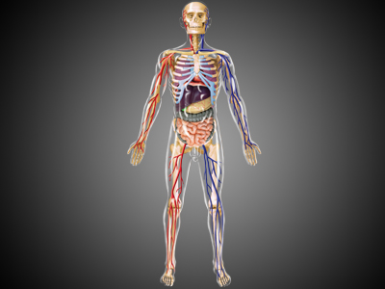
Agent Portals of entry
Agent Entry
Inhalation
Ingestion
Absorption
Vertical transmission (parent to child)
Sexual contact
blood borne
*portals of exit are also important to recognize!

Slide 40
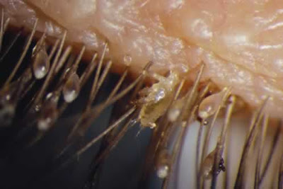
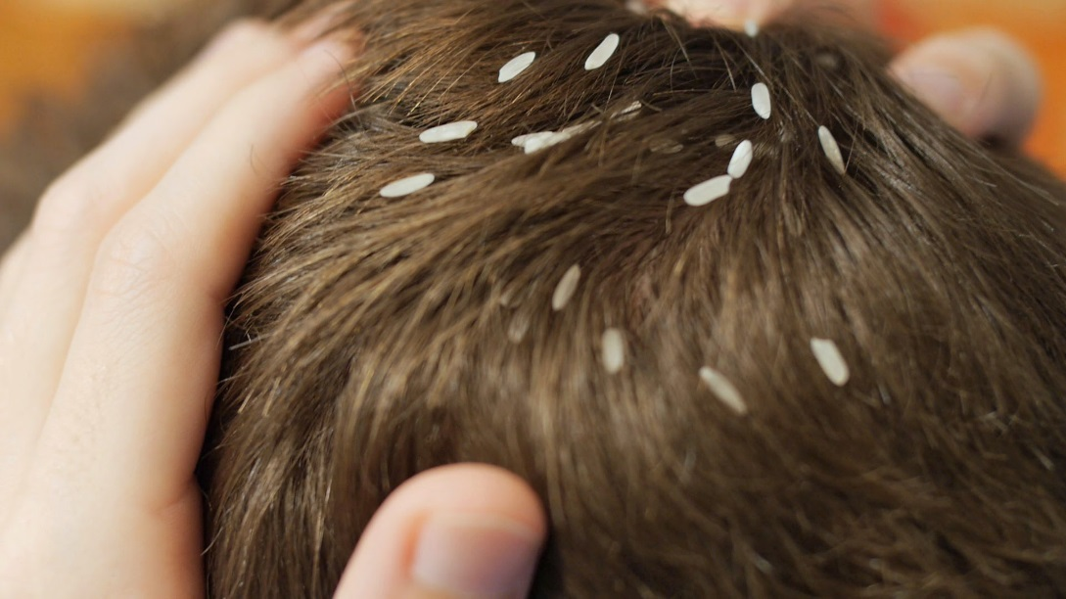
Infestation vs. infection
Infestation is when the agent lives on the external surface of the host (e.g. scabies, lice) and an infection is when the agent enters into the host.

Slide 41
reservoirs
Animate or inanimate sources which normally harbor infectious agents and serve as potential sources of disease outbreak
HUMAN – Sexually transmitted diseases, measles, mumps, *small pox
ANIMAL – anthrax (sheep), plague (rats), rabies (rabies)
ENVIRONMENTAL – soil (tetanus, fungus), water (legionnaires disease)

Slide 42
attack Rate: tells us what proportion of people who were exposed (i.e. at risk), became ill. often used in outbreak management related to food-borne illness Can also have secondary attack rate – those who became ill as a result of being exposed to a primary case
# of people exposed (at risk) to agent who become ill
# of people who were exposed (at risk)
X 100

Slide 43
Case Fatality Ratio:
# deaths due to diagnosed case in a given period
# of diagnosed cases during the same period
X 100
*Typically used to measure short-term mortality from an acute disease
Notes:
When considering mortality data, case fatality important as it is a measure of disease severity. This is typically used to determine the fatality of short-term, acute onset disease
Expressed as a proportion (ratio).

Slide 44
Host
Agent
Trans-mission
Environ-ment

Slide 45
Host susceptibility
The human to which an agent gains entry and multiplies, causing infection
Host reaction to an infectious agent is variable – depending on agent characteristics, dose of exposure, and host immune response
INCUBATION PERIOD – time between initial infection and onset of clinical disease
LATENT INFECTIONS – agent has entered the host and may be transmitted (with or without clinical signs). Latency period may be longer than the incubation period (e.g. measles, flu) or shorter (e.g. SARS and EBOLA). Latent infections may or may not become clinical in the primary host.

Slide 46
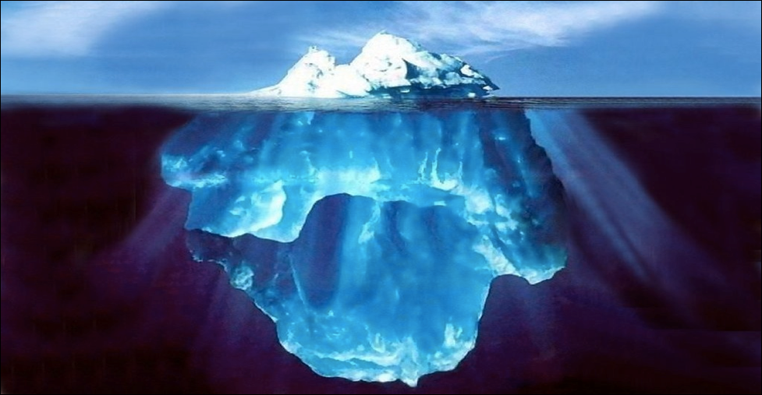
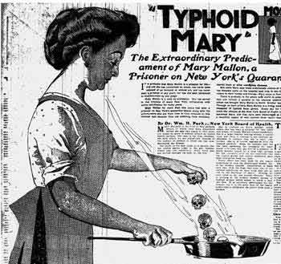
Clinical and subclinical disease
Clinical Disease – disease is apparent due to signs and symptoms
Subclinical Disease: - no clinical signs and/or symptoms
Host may harbour and agent, but not be infected or have clinical disease, but they are able to transmit disease to others (i.e. carrier)
Notes:
“typoid Mary” – I prefer to call her carrier Mary. Over a period of years, she was thought to cause 10 typhoid outbreaks – 51 cases and 3 deaths

Slide 47
Host defense mechanisms:
Degree and severity of infection is dependant upon the host’s ability to divert agents from finding entrance in the first place (skin, mucosal surfaces, flushing, sweat, and avoidance!) and the ability of the host to respond to an infectious agent’s entrance by fighting it (immune response)

Slide 48
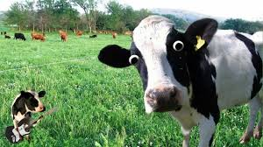
Vaccinations for disease control
First vaccine developed was for smallpox
“vacca” – meaning cow
Edward Jenner (1796)
Based primarily on observational data and not on any real solid understanding of biology or the concepts of infectious disease
Notes:
Vaccination was used specifically after the onset of “cowpox inoculation or vaccine inoculation”

Slide 49
Host Immunity
Developed through the presence of disease specific antibodies which are developed to neutralize or destroy agents.
ACITVE IMMUNITY – occurs when disease triggers the immune system to produce antibodies either naturally (infection with disease) or vaccine-induced immunity (introduction of disease in killed or weakened form). Protection is delayed, but lasts potentially a life-time.
PASSIVE IMMUNITY – host acquires disease-specific antibodies naturally (e.g. mother to baby transfer) or artificially with direct administration of immune globulins (e.g. rabies). Protection is immediate, but short lived.

Slide 50
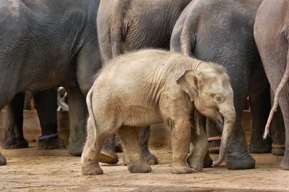
HERD immunity: LINK to Video 1 Link to Video 2
http://www.freedigitalphotos.net/ worradmu
Protectionfor all, based on immunity of many
Notes:
It is not just about individual immunity, it is about immunizing a POPULATION (collective protection).
If a person becomes infected, the likelihood of them “bumping” into a susceptible host is rare.
With immunization, may not have to immunize 100% of the population…the rest protected by the “herd” (typically need 85-90% of the population vaccinated)
Need heterogeneous (random mixing of) populations…if the infected person is only in contact with other hosts that are susceptible, then the probability of spreading disease is higher.
No magical number for herd immunity to occur…depends on the disease.
Higher always better.

Slide 51
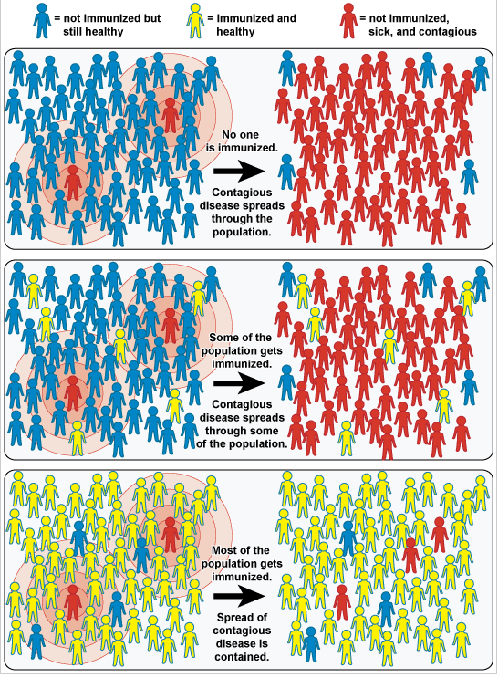
LINK

Slide 52
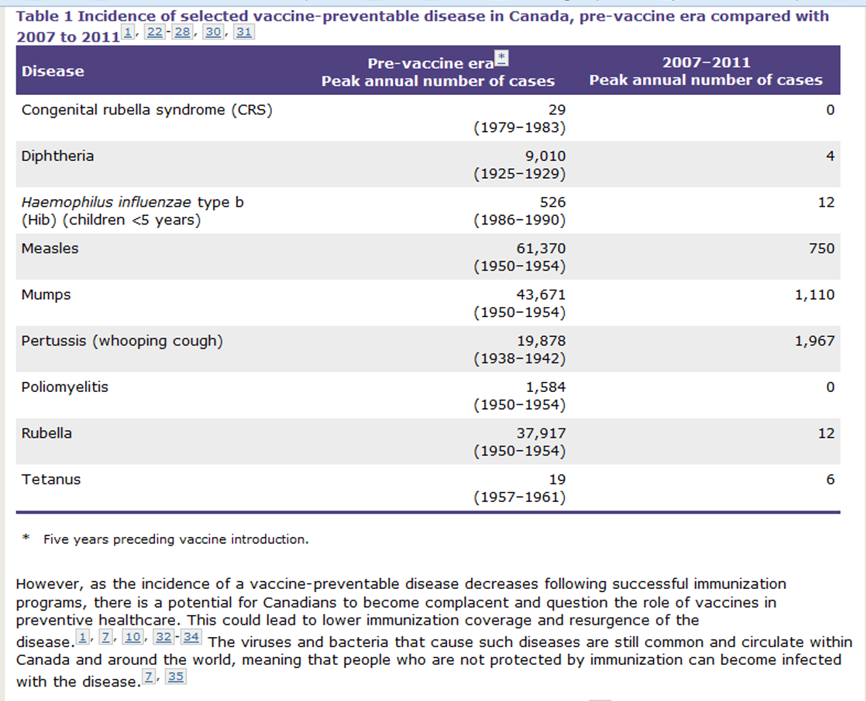
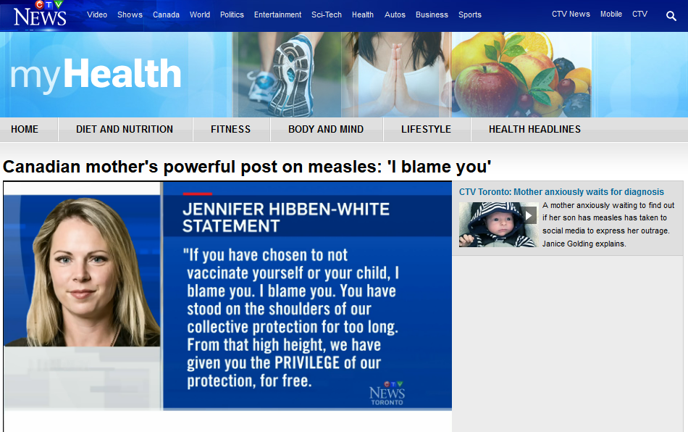
why vaccinate? You decide, but know the science…
LINK to article/video

Slide 53
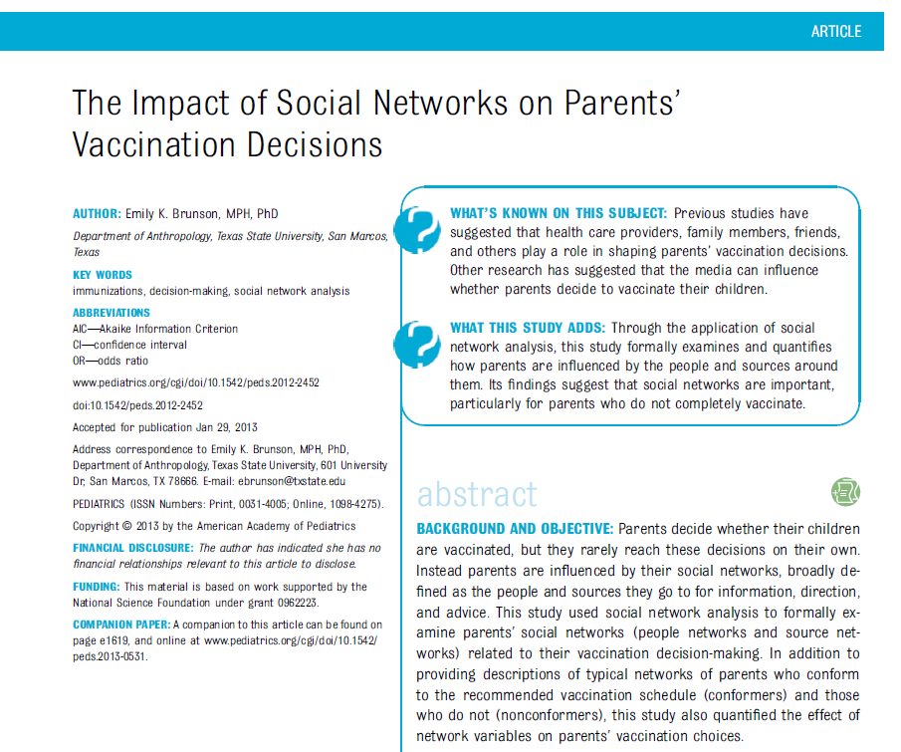
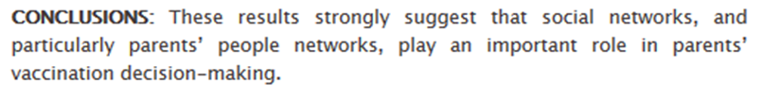
Where are vaccine decision makers getting their information?

Slide 54
Host
Agent
Trans-mission
Environ-ment
Notes:
ENVIRONMENT: all external factors, other than the agent and the host that influence health (e.g. temp, humidity, housing , water, food, radiation, toxins, altitude)

Slide 55
Environmental determinants: affect the agent’s ability to survive & thrive , and the host’s potential exposure & susceptibility to the agent
Physical environment – climate change, changes to land, human interaction with agent reservoirs, environments not conducive to protection, creation of breeding sites
Social environment – burial practices, overcrowding, contact behaviours, travel, urbanization,
Political environment – war, globalization, migration, economics, tourism, support/implementation of programs
Often environments are influenced by humans, making them more favourable. (humans may also deliberately make environments less conductive to agent’s survival or transmission)
Notes:
Travel: almost 2000 cases of malaria per year in the united stated (almost ALL from travellers); Use of prevention measures

Slide 56
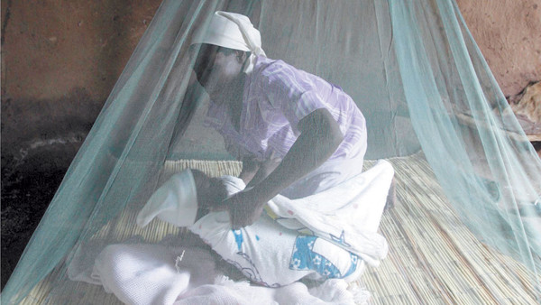
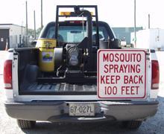
Malaria and the environment?
Stagnant water
Farming practices
Control measures
Travel practices
Urbanization
Level of education
Familial practices
Building structure
Rainfall and humidity
Political will
LINK Mosquito control in Lethbridge?

Slide 57
Epidemiologic Triangle
Host
Agent
Transmission
Environment
Link

Slide 58
Contact transmission
DIRECT - Person to person through direct physical contact between infected person and susceptible host (e.g. kissing, touching, sexual contact)
INDIRECT – agent deposited on a fomite and survives long enough to transfer to susceptible host
fomite is an inanimate object that can be a vehicle for transmission
DROPLET – via coughing or sneezing from infected person to susceptible host
Notes:
22

Slide 59
Non-contact transmission (a form of indirect transmission)
AIRBORNE – transmission via aerosols which enter through the respiratory tract. Can be present in the air, ventilation systems, abattoirs and remain there for a long time
VEHICLE – a contaminated source which can act as a point source for agent transmission (e.g. food, water, soil)
VECTOR – transmission of agent from a living organism to another (e.g. mosquitos, ticks, lice, other mammals)

Slide 60
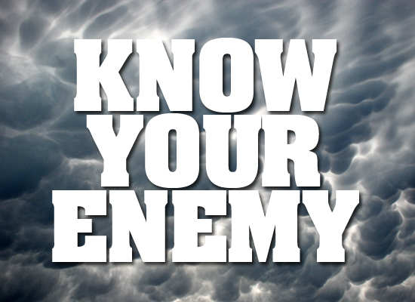
BATTLING INFECTIOUS DISEASE:
“Man’s struggle against emerging infections has been a fundamental determinant of the existence and evolution of the human species.” -Morens et al. (2008)

Slide 61
Putting up a fight
CONTROL – goal is to reduce infection incidence, prevalence, morbidity, and mortality to an acceptable level (e.g. diarrhoeal disease) so that it is no longer considered a population health concern
ELIMINTATION – reduction of incidence to zero from specific geographic areas (e.g. polio)
ERRADICATION – reduction of worldwide incidence of disease to zero (e.g. small pox)
EXTINCTION - infectious agent no longer exists naturally or in the laboratory (none known)

Slide 62

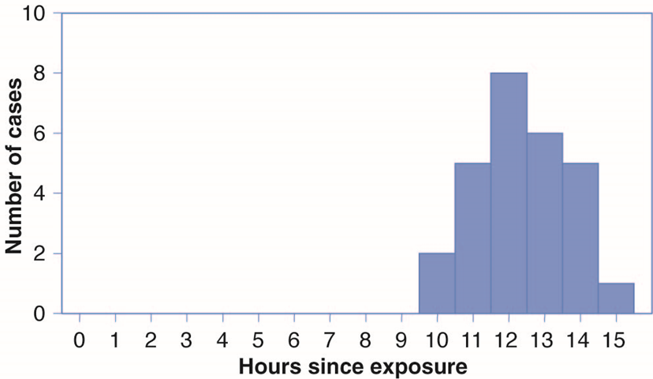
Point source epidemics
A sudden exposure to the same infectious agent from a common point or a common vehicle
Can plot this on an epidemic curve
Cases (defined by onset of
Symptoms) are plotted
against time since exposure…
This tells us about the
average incubation period

Slide 63
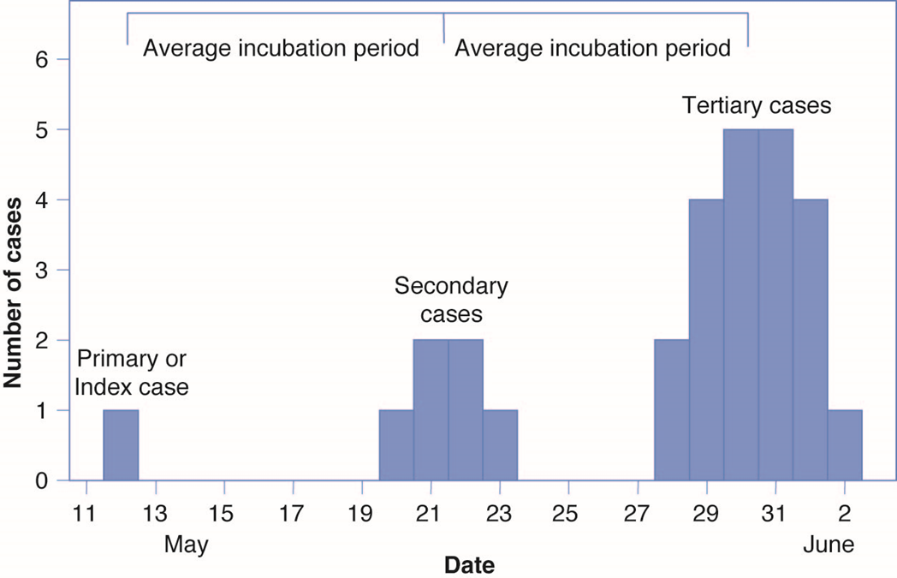
Propagative (progressive) epidemics
Introduction of agent to a susceptible population with subsequent transmission from person to person and increasing incidence.
First cases is the INDEX (PRIMARY) case, then there are secondary and then third, forth, etc. generation cases
Notes:
Includes more than one incubation period.
This continues until control measures are in place or until all susceptible hosts are exhausted.

Slide 64
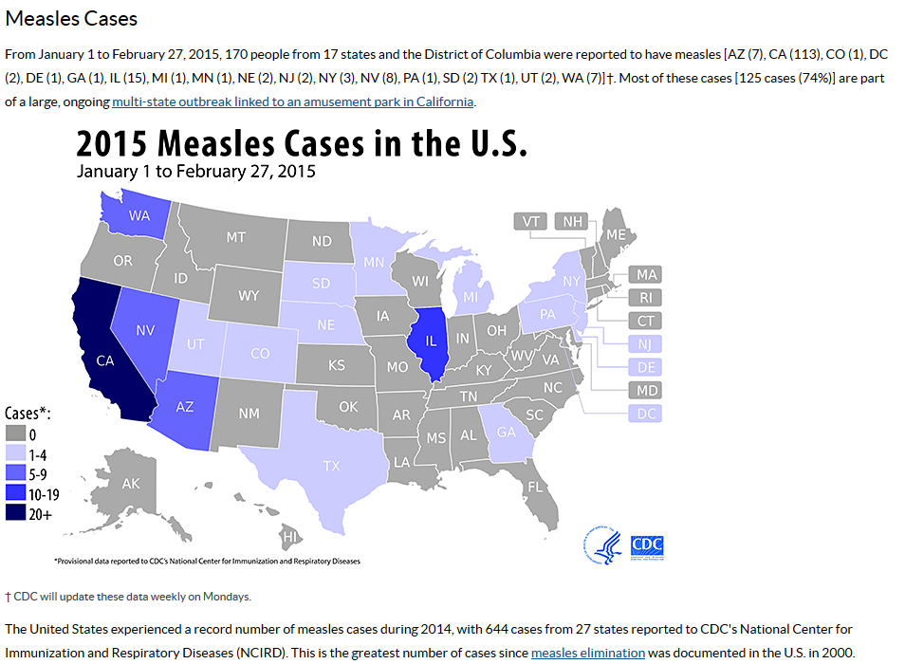
Point source or propagative epidemic?
Reason for the outbreak?
Notes:
The reason the secondary cases are not greater is likely due to the availability of susceptible hosts and contact with cases.

Slide 65
Basic Reproduction NUMBER(R_{o}):
The average # of secondary cases of disease that are generated by a typical primary case in a susceptible population.
R_{o} = 1 = each primary case replaces itself and the disease will be endemic
R_{o} > 1 = each primary case produces more than one secondary case and cause an epidemic
R_{o} < 1 = each case does not produce enough cases to replace itself and disease will be elimination of disease
Notes:
R_{O} for measles is 12-18
For small pox it is 5-7
The larger the number, the more difficult it is to control disease withn a population.

Slide 66
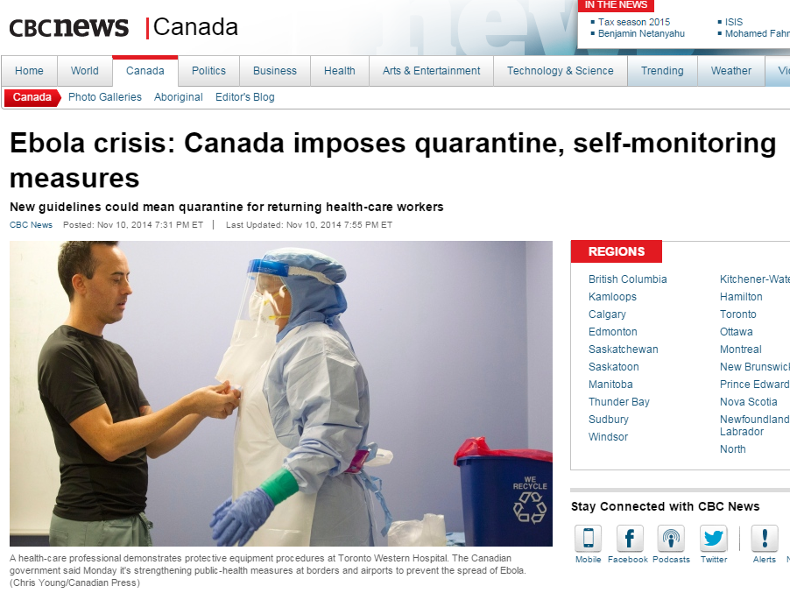
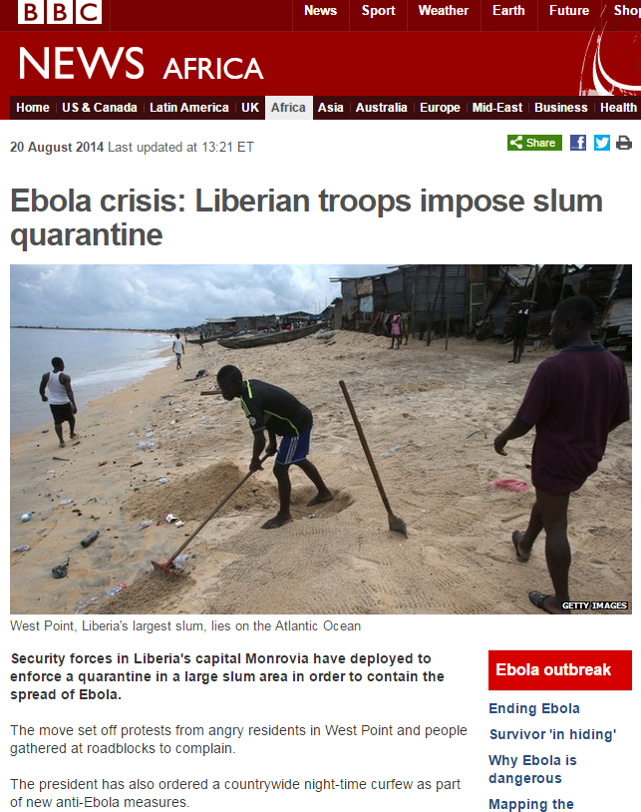
Quarantine & isolation measures
Quarantine separates or restricts movement of people who were exposed (at risk) to an infectious agent to see if they become sick.
Isolation separates people infected from those who are not sick.

Slide 67
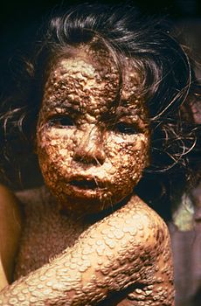
1st Infectious Disease to be Eradicated: Small Pox
Small pox emerged ~10,000 BC. Evidence of small pox on Egyptian mummies.
Case-fatality ratio: 20-60%. Responsible for 300-500 million deaths in the 20th century *INOCULATION EFFORTS
LINK to
Smallpox
Timeline
Strong vaccination uptake after invention.
1979 - WHO certified the eradication of smallpox. But still exists in various labs
Considered bioterrorist weapon as mass vaccinations ended in the 1970s.

Slide 68
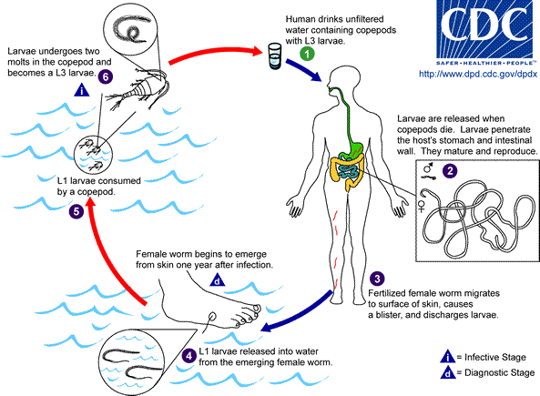
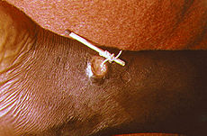
2nd Infectious disease to be Eradicated? Progress Being Made: Guinea Worm Disease
Roundworm ingested in water.
One year later – Female worm burrows to skin surface.
Creates burning sensation
Wait for human host to go into water – live oral birth of worms from her mouth (up to 3 million) back into water.
Link to Centres for Disease Control

Slide 69

Finally, a Good News Story…
LINK to National Geographic article
LINK to CDC
LINK to Carter Center
Video

Slide 70
Criteria for eradication
It is biologically and technically possible to eradicate the disease
The benefits of eradication outweigh the cost of eradication efforts
Social and political acceptance and support
Notes:
CDC: the principles of disease elimination and eradication (1999)

Slide 71
Conditions for occurrence of epidemics
Emerging (re-emerging) infectious agent
Increasing susceptibility of the host
Altered environments, enabling agent transmission
Introduction of new route of transmission
Failure of control methods (e.g. antimicrobial resistance)

Slide 72
EPIDEMIC (Outbreak) management:
Confirm that an epidemic exists (is it clearly “in excess of what normally exists in this population in this time”?)
Establish a case definition and count cases as they occur (what is the criteria for being a case - this may change)
Assess the extent of the outbreak and the features of the suspected disease (may need to find those who are mildly or moderately ill and not presenting in the hospital. Consider survey to locate potential cases)

Slide 73
OUTBREAK MANAGEMENT CON’T:
What will you communicate with the public?
Define the population at risk (determine who may be at risk due to exposure - these become the denominator in your attack rate)
Formulate a working hypotheses and test – what is the source or nature of the epidemic? (document cases, create spot maps, look for clusters, draw an epidemic curve, note anomalies). Try to isolate the source and agent.
Plan for long-term prevention and control (determine ways to prevent future outbreaks. Immunization?)

